Slide 1
Unleashing The Power of IUL: Secrets of Accumulation & Distribution

Slide 2
AGENDA
Financial Offense
Financial Defense

Slide 3
Financial Risk Spectrum
If You Die
When You Die
Retirement
Income Replacement
Reduced Social Security Income
$
$
Mortgage Payoff
Health Care Costs
Kids to College
Financial Risks
20-40 Years Prior to Retirement
Retirement Years
3 big risks get smaller over time.
3 other big risks get larger over time.

Slide 4
Financial Risk Spectrum
If You Die
When You Die
Stock Market Corrections
Home Ownership Expenses
Low Interest Rates
Increasing Tax Rates
Under-Saved
Spent Too Much Too Soon
Retirement
Income Replacement
Reduced Social Security Income
$
$
Mortgage Payoff
Health Care Costs
Kids to College
Financial Risks
3 big risks get smaller over time.
3 other big risks get larger over time.

Slide 5
IUL Secrets of Accumulation
Minimum Funding:
True Life Insurance
$
Your Cash
Time

Slide 6
IUL Secrets of Accumulation
Maximum Funding:
True Life Insurance
Your Cash
Under the “Cash Value Corridor Test,”
the policy’s cash value can actually
equal the death benefit at age 95.
Time

Slide 7
IUL Secrets of Accumulation
Up 10%; Down 10%

Slide 8
IUL Secrets of Accumulation
Up 10%; Down 10%

Slide 9
IUL Secrets of Accumulation
Up 10%; Down 10%

Slide 10
IUL Secrets of Accumulation
Up 10%; Down 10%

Slide 11
IUL Secrets of Accumulation
Up 10%; Down 10% – With Caps & Floors

Slide 12
IUL Secrets of Accumulation
Up 10%; Down 10% – With Caps & Floors
$161,000
$95,000

Slide 13
Death-Benefit-Focused IUL
Premiums: Small, Medium & Large

Slide 14
Death-Benefit-Focused IUL: Assumptions
Male, age 30, Preferred Non-Tobacco
$400,000 Option A
Premiums paid monthly to age 65, then stopped
Max Accumulator illustrated at 7.44%
Minimum Premium: Carries the illustration to age 121 under current assumptions
Maximum Premium: Guideline Maximum Premium
Medium Premium: Right between the Minimum and Maximum premiums

Slide 15
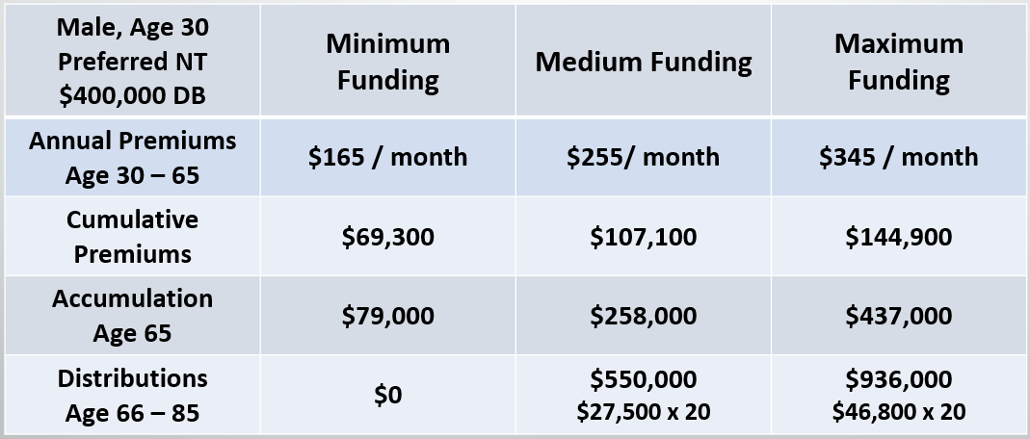
Death-Benefit-Focused IUL: Small, Medium & Large

Slide 16
Death-Benefit-Focused IUL
IUL vs. GUL

Slide 17
Death-Benefit-Focused IUL: Value+ Protector (VPP) vs. Secure Lifetime GUL 3
Secure Lifetime GUL-3 guaranteed to age 100
VPP Illustrated at 6.00%; MLSB; Guideline Premium Test
All insureds = Male, Preferred Non-Tobacco
All Death Benefits = $500k; Option A
All Premiums = Monthly Bank Draft, Continuous Pay
Solve for GUL 3 premium; then pay that premium into VPP
Notes:
Let’s set the stage for how this comparison works.
We’ll illustrate Secure Lifetime GUL-3 so that the death benefit and premiums are guaranteed to age 100.
Value+ Protector will be illustrated at 6.00% using the MLSB index and the guideline premium test.
All of the insureds in this example will be Males, using the Preferred-Non-Tobacco underwriting class.
All death benefits will be $500,000; using an Option A death benefit.
All premiums will be paid using Monthly Bank Draft, and will be paid on a continuous basis for the life of the illustration
So here’s how I created the numbers. I started by solving for the Secure Lifetime GUL-3 premium that guarantees the death benefit to age 100. Then I paid the exact same premium into the exact same death benefit using Value+ Protector, and compared the results.
Let’s look at how it turned out.

Slide 18
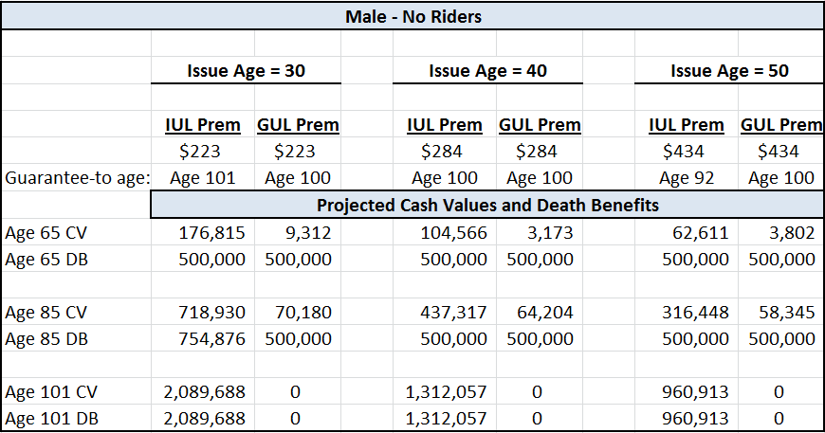
Death-Benefit-Focused IUL vs. GUL

Slide 19
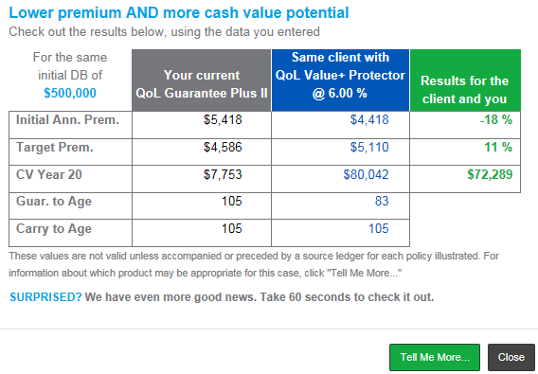
New WinFlex-Web Pop-Up Window

Slide 20
Agenda
Financial Offense
Financial Defense

Slide 21
Cash Accumulation IUL

Slide 22
Do You Want To Be In A Lower Tax Bracket?

Slide 23
Do You Want To Be In A Lower Tax Bracket?
There are only 3 ways to be
in a lower tax bracket during retirement:
The IRS reduces overall tax rates
You live on less income (reduce lifestyle)
Generate as much tax-free income as possible!

Slide 24
Do You Want To Be In A Lower Tax Bracket?
You can “opt out” of the statistic:
The IRS reduces overall tax rates
You live on less income (reduce lifestyle)
Generate as much tax-free income as possible!

Slide 25
Do You Want To Be In A Lower Tax Bracket?
You can “opt out” of the statistic:
Today you can choose Option 3!
The IRS reduces overall tax rates
You live on less income (reduce lifestyle)
Generate as much tax-free income as possible!

Slide 26
Contribution – Accumulation – Distribution
The $5 - $10 - $20 Story

Slide 27
Additional Benefits:
Self-Completing at owner’s death
No set limit on contributions¹
Pre age 59 ½ access
No income tax or penalty tax²
Catch-up on missed contributions
No RMDs for owners
No RMDs for beneficiaries
Upside market performance without downside market risk
$5
$10
$20
If you had access to a retirement strategy that provided you with the tax
treatment you want, and you could put in as much money as you want,
how much would you put into a plan like that every year?
The Bad News: You must pay tax on one of these three
The Good News: You get to choose
Where are the bulk of your retirement assets currently invested?
Which of the numbers above is going to get taxed?
Wouldn’t it make sense to diversify a portion of your portfolio?
Policy must comply with IRS requirements to qualify as a life insurance contract. Total premiums in the policy cannot exceed funding limitations under IRC 7702.
Assumes the policy is not a Modified Endowment Contract Withdrawals during the first 15 years of the contract may be treated as income first and includible in policyholder’s income.
Notes:
This slide is identical to the next slide, but shows looks incorrect on this slide, but is visible on the next (hidden) slide. The overlapping text reveals perfectly when running in Slide Show Mode during a presentation. The script for both slides will be identical. All of the overlapping text on this slide can be easily seen on the next slide, which prints in a printed version, but the next slide does not appear in Slide Show Mode. Please do not delete the next slide!
To get the conversation started, I simply write $5, $10, and $20 on the corner of the napkin or piece of paper. I then tell my prospect that this represents their retirement plan. (Remember how we just noticed, in Darren’s case study, that the accumulation was more than double the contribution, and the distribution was nearly double the accumulation?)
I go on to tell them that every dollar of their retirement goes through three phases: the contribution phase, the accumulation phase, and the distribution phase. For purposes of our conversation I’m going to represent the contribution phase with the $5, the accumulation phase with the $10, and the distribution phase with the $20.
Now, as pertains to these three phases, I have good news and I have bad news:
The bad news is that the IRS will require you to pay taxes on at least ONE of these three phases.
The good news is that the IRS doesn’t dictate which one it will be. They leave that decision up to you, based on the investments you choose.
Now that you know the choice is up to you, please circle which one of these three you’d prefer to pay taxes on! This literally never fails. People tend to circle the $5 contribution.
To that I respond with: Well, isn’t that interesting. Allow me to ask you a question: where is the bulk of your retirement assets currently invested?
Most will respond that the majority of their retirement savings is in their employer-sponsored plan (401(k), etc.).
To which I respond: And which of these numbers is going to get taxed on those assets? They, of course, recognize that they’re going to pay tax on the $20 distribution.
So I’ll say: Isn’t it interesting that the vast majority of your retirement savings is set to be taxed the exact opposite of the way you’d want it to be taxed if the choice was up to you? Do you think it would make sense to consider diversifying a portion of your portfolio to get the tax treatment you really want? (Typically they’ll agree.)
So my final question is: If you had access to a retirement strategy that provided you with the tax treatment you want, and you could put in as much money as you want, how much money would you consider putting into a plan like that every year? Then just keep quiet and wait for their response.
After they respond, you can tell them that you have a “widely available but rarely discussed” strategy that works like that. It has a list of additional benefits that might interest you. Let’s review the list:
This strategy has a self-completing component that provides a death benefit to your heirs and beneficiaries in the event you die prior to completing your scheduled funding.
You have greater flexibility. It’s not like a 401(k) or IRA where you can only invest a limited amount per year. Your contributions are only limited by your health and your financial situation. You can also discuss that, once the policy is purchased, the policy will have a maximum amount that can be contributed.
You can access the account values prior to age 59 ½ without incurring any income tax or penalty tax.
If you skip or reduce your contributions in any year, you can make-up, or catch-up, on those missed contributions in the future.
There are no mandated RMDs (Required Minimum Distributions) for you while you’re alive, and. . .
There are no mandated RMDs for your beneficiaries.
Now how much would you like to contribute each year, knowing that you can skip or reduce contributions and then catch-up on those contributions at any point in the future, giving you incredible financial flexibility?

Slide 28
Case Study: Tony
Age: 40, good health (Preferred Non-Tobacco)
Occupation: Attorney
Annual W-2 Income: $400,000
Targeted Retirement Age: 67 (full Social Security benefits)
Targeted Annual Retirement Savings:
10% of W-2 income = $40,000
Current annual contributions to 401(k): – $18,000
Additional annual amount targeted to contribute: $22,000
Notes:
To give some credence to the many things we’ve discussed so far, let’s put the theory into practice by examining a hypothetical example.
Let’s talk about Tony Li, a 40-year-old attorney in good health. Tony’s successful practice provides him an annual income of around $400,000.
As a 40-year-old, Tony knows that his “normal retirement age” for purposes of Social Security benefits is age 67. He enjoys his career, and sees no reason why he would stop working prior to that.
Tony has always been a pretty good saver. He has always maximized his contributions to the 401(k) he created for himself and his employees. He has always targeted socking away at least 10% of his annual income. 10% of his $400,000 annual income would suggest a targeted savings goal of $40,000 per year.
Tony maximizes what he can contribute to his 401(k), currently investing $18,000 per year, and doesn’t know what to do with the other $22,000 that he needs to invest each year to achieve his target of setting aside 10%, or $40,000, per year.
One thing he could consider is Life Insurance.

Slide 29
Case Study: Tony
Life Insurance Policy Assumptions (Max Accumulator+ IUL):
Minimum death benefit (Initially $582,000)
Underwriting Class: Preferred Non-Tobacco
Option B increasing death benefit during contribution phase
Option A level death benefit during distribution phase
Assumed illustrated rate: 7.44%(current rate as of 7/2/18 using MLSB)
Pay premiums to age 67
Loans for 25 years beginning at age 68
Cash value projects at over $2M at age 100, after taking income
Notes:
Let’s review how we could help Tony out, using a maximum-funded life insurance strategy.
When using life insurance with a focus on retirement accumulations, protected by the policy’s death benefits, it’s common to structure the strategy with a minimum death benefit. That death benefit is normally significantly more than the annual contributions. In Tony’s case, he can contribute premiums of $22,000 per year if he has a death benefit of at least $582,000. That’s over 25 times greater than his annual contributions, which is the “self-completing” portion of Tony’s plan.
Because of his good health, we’ll assume that Tony qualifies for the “Preferred” underwriting class. (Not Super-Preferred… just ordinary Preferred)
During Tony’s premium-paying years, we’ll use what we call an “option B – increasing” death benefit. This means that Tony’s death benefit will exceed his account value by $580,000 during the entire funding period. At age 67, when Tony stops paying premiums and begins taking distributions, the plan will be “fully funded” and we no longer need to pay the expense of an increasing death benefit. So, at age 67, we’ll change the policy to a level death benefit for the balance of his life.
Our projected values are based on the March 1, 2018 illustratable interest rate of 7.44% for the MLSB index.
In our example, Tony will pay premiums until age 67 (his Social Security “full retirement age”), and begin a series of equal distributions for the next 25 years, beginning at age 68.
Let’s look at the projected results.

Slide 30
Case Study: Tony
Will Tony be glad he paid tax
on the $594k and not the $4.3M?
Maximum Funded Life Insurance may be
the only way to achieve these results!
Assumptions: Max Accumulator+ IUL. $22,000 annual contribution for 27 years.
$172,800 distributions for next 25 years. 7.44% projected rate
This is not an actual case. This hypothetical example is for illustrative purposes only. Rates as of July 2, 2018.
Notes:
Here is a graphical representation of Tony’s plan. For visual learners, you can see graphically that Tony’s accumulation is more than double his contribution, and his distribution is more than double his accumulation. This doubling effect is just like the $5 - $10 - $20 story.
If this scenario were to actually “play out” this way, do you think Tony will be glad he paid tax on the $594,000 contribution (after-tax premiums) rather than on his distributions of over $4.3 million? Mathematically he has taken out, income-tax-free, more than SEVEN TIMES what he put in.
Maximum-funded life insurance may be the only way to achieve results like these. Why? In large part because of the tax advantages of life insurance.

Slide 31
Case Study: Tony
Includes $580k of AAS:
Indemnity-based Chronic Illness up to $46k per month
Assumptions: Max Accumulator+ IUL. $22,000 annual contribution for 27 years.
$172,800 distributions for next 25 years. 7.44% projected rate
This is not an actual case. This hypothetical example is for illustrative purposes only. Rates as of July 2, 2018.
Notes:
And… All of the numbers on the screen include American General’s chronic illness rider called Accelerated Access Solution.
In this scenario I illustrated the policy with the AAS benefit equal to the full death benefit of $580,000. Although today’s HIPAA limits would restrict the monthly payout of the AAS benefit to today’s monthly limit of $10,800, the policy owner has years and years of inflation protection. As the HIPAA limit increases in the future, the maximum monthly benefit that Tony can access increases.
So the AAS monthly payout is always the lesser-of:
The HIPAA per-diem limit in effect at the time the insured goes on-claim; and
The policy’s maximum limit of $46,666 per month.

Slide 32
Target Audiences
Doctors
Dentists
Attorneys
CPAs
Chiropractors
Veterinarians
Funeral Home Directors
Successful business owners
High-income executives
At-home spouses
32
Notes:
There are several professions that are a natural audiences for this type of strategy:
Read through and discuss the occupations.
When you get to the last bullet, mention that it’s not unusual for these high-income-earning professionals to have an at-home spouse raising the family. In that role, the at-home spouse doesn’t have his-or-her own 401(k) or other retirement plan to contribute to. In fact, they aren’t typically even contributing to Social Security, which means they’re not building their own social Security record. In those cases, a life insurance policy may be an alternative they can consider for creating retirement accumulations for that at-home spouse.

Slide 33
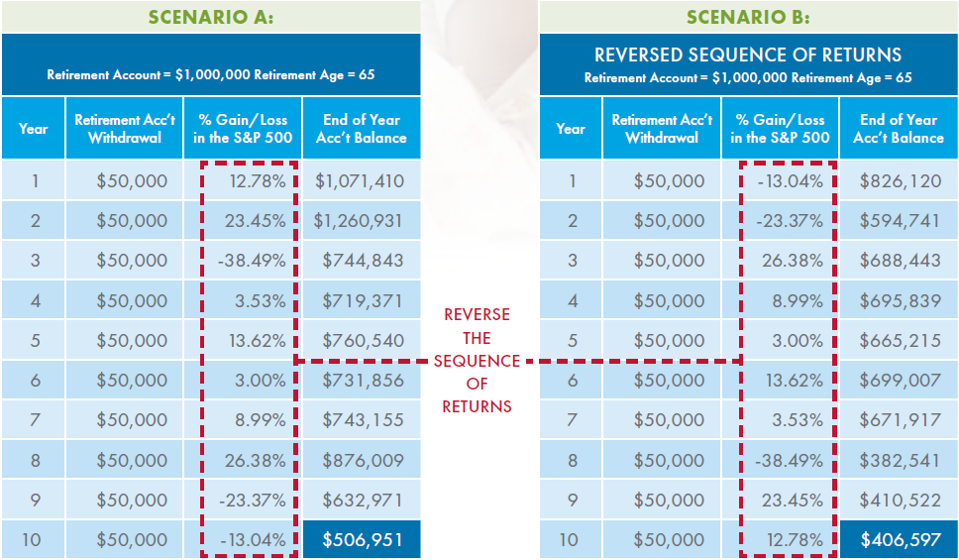
Let’s Talk About “Retirement Income”
Not an actual case, and is a hypothetical representation for illustrative purposes only. The annual values presented above are based on the values of the S&P 500 without dividends at the end of that year. Rates as of July 2, 2018
Notes:
The brochure contains this analysis. It’ not my objective to explain the purpose for this analysis within the brochure. More importantly, it provided me with actual S&P 500 index numbers for a ten-year period of time (2001 – 2010). These returns were run backwards on the left (shown from 2010 to 2001) and then reversed on the right (showing 2001 to 2010).
All I wanted to do was grab those actual returns so I could demonstrate a concept that you might find helpful.

Slide 34
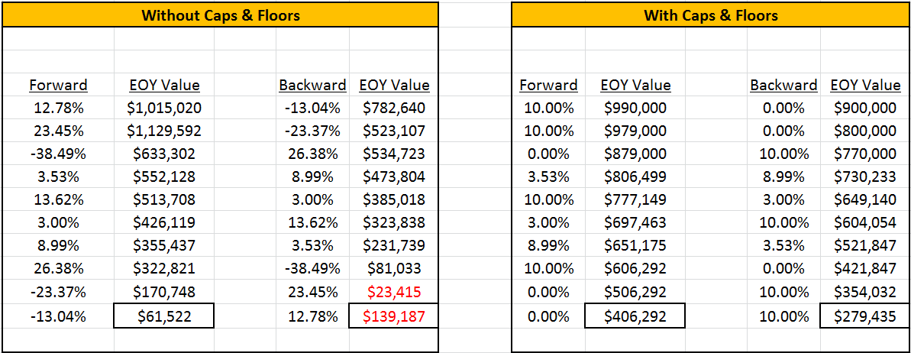
Let’s Talk About “Retirement Income”
$1M initial balance; $100k annual withdrawals
Rates as of July 2, 2018
Notes:
So I took those returns and dropped them into an Excel spreadsheet. Then, using those returns, I started with a $1,000,000 initial balance, and took out $100,000 per year for 10 years (taking out a total of $1,000,000). As I took those distributions, I had the values grow-and-shrink based on the performance of the S&P 500 index.
You can see that, when I ran those withdrawals through the “Forward” S&P returns, the residual value at the end of 10 years was $61,522. It barely survived.
But on the right, when I reversed the returns and did the exact same thing, look what happened. Not only did we run out of money, but we ended up negative by $139,187!
How did the exact same returns produce such a different result? Its because of the timing of the returns. You’ll notice that, on the right, two years of significant negative returns occurred right away. On the left, only one negative return occurred in the first eight years, and it wasn’t until the third year.

Slide 35
Let’s Talk About “Retirement Income”
$1M initial balance; $100k annual withdrawals
10% Cap; 0% Floor
Rates as of July 2, 2018
Notes:
But now let’s see what happens if we apply one of the principles of indexing in an insurance product. We’ll take those exact same returns, but we’ll give them a 10% cap and a 0% floor, and see what happens.

Slide 36
Let’s Talk About “Retirement Income”
$1M initial balance; $100k annual withdrawals
10% Cap; 0% Floor
$344,770
$418,622
Rates as of July 2, 2018
Notes:
Now the 12.78% return is capped at 10%.
And the 23.45% return is capped at 10%.
And the 38.49% negative return has a floor of 0%.
Look at what happened.
When the returns are run forward, the $61,522 increased by $344,770 to $406,292!
And the $139,187 negative increased by $418,622 to become a $279,435 positive balance!
So you started with $1 million, took out $1 million, and still had either $406,000 or $279,000 remaining!
This is sort of like comparing the difference of an unprotected portfolio to one that’s protected by caps and floors.
Notice that it’s not as much about keeping your upside potential during retirement, as it is about reducing or eliminating the impact of the downside risk.

Slide 37
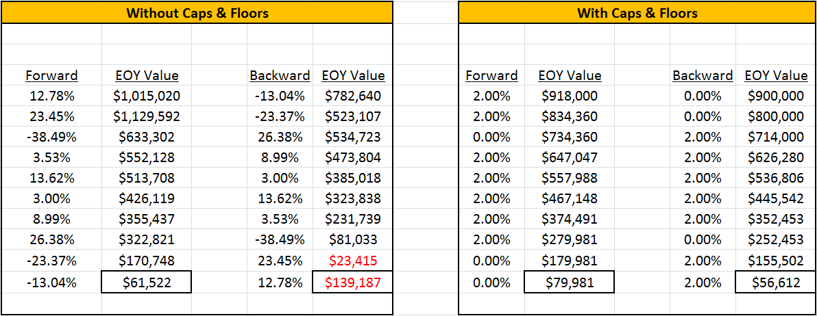
Let’s Talk About “Retirement Income”
$1M initial balance; $100k annual withdrawals
2% Cap; 0% Floor
Rates as of July 2, 2018
Notes:
Here is the same grid on the left again… no changes.
Sometimes I hear people say “But the insurance company always keeps it’s hands on a few levers, and one that everyone worries about is the Cap Rates. What if the insurance company lowers the Cap Rate?”
So in this example, I’m going to run the exact same example, but I’m going to lower the cap rate from 10% to just 2% to see what happens.

Slide 38
Let’s Talk About “Retirement Income”
$1M initial balance; $100k annual withdrawals
2% Cap; 0% Floor
$18,459
$195,799
Rates as of July 2, 2018
Notes:
So in this example, I’m going to run the exact same example, but I’m going to lower the cap rate from 10% to just 2% to see what happens.
Now the 12.78% turns into just 2%
Same with the 23.45%
And the 38.49% negative still had its 0% floor.
So none of the returns on the right exceed 2%.
Look what happened.
The $61,522 was still increased by $18,459 to $79,981.
And the $139,187 negative was increased by $195,799 to become a $56,612 positive balance.
That’s pretty incredible, and it underscores that, during distribution, it’s not so much about the upside potential as it is about the reduction or elimination of the downside risk.

Slide 39
And Non-Medical, Too!
Max Accumulator+
Issue ages 0 – 50
Available up to Preferred Plus
Death Benefits up to $499,999 (in a 12-month period)
No labs, fluids, paramed exams, physical exams, or APS’s
Brief phone interview = Part B medical questionnaire
Chronic Illness Rider (AAS) is available
Notes:
Now that you understand these indexing principles, check this out.
Your clients can now access AIG’s cash accumulation IUL on a Non-Medical basis, subject to certain limits.
It’s only available on our Max Accumulator IUL… it’s not available on Value+ Protector.
It’s only available on issue ages up-to-and-including age 50
All “standard” underwriting classes are available for both tobacco and non-tobacco. We used to have Standard Non-Tobacco and Standard Tobacco as the best classes you were eligible for. Now it’s available for Preferred Tobacco, Preferred Non-Tobacco, and Preferred Plus Non-Tobacco
Because we have a rate band that changes at $500,000, the maximum death benefit eligible for the Non-Medical program is death benefits under $500,000. So the maximum death benefit is $499,999. The caveat is that this maximum available death benefit is based on all death benefits issued through AIG companies within the prior 12 months. So, for example, if you purchased a $200,000 term policy 8 months ago, your maximum death benefit would be the remaining $299,999 that gets you to a total of $499,999. However, if the most recent policy you had issued with an AIG company was more than 12 months ago, you’re eligible for the entire $499,999.
Because it’s a non-medical program, we don’t require any labs, fluids, paramed exams, physical exams, or APS’s.
We will require a completed Part-B of the application, which is often completed over the phone by one of our professional tele-interviewers. The rest of our information comes from database sources such as MIB, a prescription drug database, and the applicant’s MVR (Motor Vehicle Record).
And the Accelerated Access Solution Chronic Illness rider is also available as part of this Non-Medical program.

Slide 40
And Non-Medical, Too!
Max Accumulator+ Maximum Monthly Premiums
(Option B; Includes AAS)
 | Male Issue Ages
 | 25 | 30 | 35 | 40 | 45 | 50
Preferred-Plus | $894 | $1,081 | $1,286 | $1,577 | $1,939 | $2,364
Preferred NT | $895 | $1,081 | $1,287 | $1,578 | $1,967 | $2,364
Standard NT | $897 | $1,084 | $1,289 | $1,580 | $1,969 | $2,364
Preferred Tob | $904 | $1,091 | $1,296 | $1,591 | $1,986 | $2,364
Standard Tob | $914 | $1,100 | $1,305 | $1,602 | $1,998 | $2,364
Rates as of July 2, 2018
Notes:
Rates as of May 1, 2018
So let’s think about how much money your clients can contribute under this non-medical program.
Here you can see a summary of the maximum monthly premiums your client can contribute at different ages and different underwriting classes. These are the MALE premiums. On the next slide you’ll see the FEMALE premiums.
All of these illustrations assume Option B, and include the AAS rider for 100% of the death benefit, using the Per Diem option.
As you can see, the contributions can be significant.
A 25-year-old can contribute monthly premiums of over $894 per month; almost $11,000 per year.
A 40-year-old can contribute monthly premiums of over $1,570 per month; over $18,000 per year.
A 50-year-old can contribute around $2,300 per month, or about $27,000 per year.
All without taking a physical exam.

Slide 41
And Non-Medical, Too!
Max Accumulator+ Projected 20-year Income
(Option B to Age 70, then Option A; Includes AAS)
 | Male Issue Ages
 | 25 | 30 | 35 | 40 | 45 | 50
Preferred-Plus | $371,000 | $301,000 | $242,000 | $191,000 | $147,000 | $92,000
Preferred NT | $367,000 | $298,000 | $239,000 | $189,000 | $146,000 | $87,000
Standard NT | $356,000 | $290,000 | $232,000 | $182,000 | $137,000 | $74,000
Preferred Tob | $339,000 | $273,000 | $216,000 | $167,000 | $106,000 | $51,000
Standard Tob | $332,000 | $267,000 | $209,000 | $134,000 | $104,000 | $41,000
Rates as of July 2, 2018
Notes:
Rates as of May 1, 2018.
But almost more exciting than the premiums is seeing the possible income distributions using policy loans and withdrawals.
In this chart we show the Max Accumulator+, funded with the premiums you saw on the prior slide to age 70, and then solving for income distributions for 20 years from age 71 to age 90.
So, on the prior slide a 25-year-old male Preferred-Plus could pay premiums of over $890 per month under the non-medical program. The illustration calculated projected distributions of $371,000 for 20 years – A total of over $7.4million – income-tax-free from age 71 to age 90.
A male, age 40, in the Standard Non-Tobacco band could have contributed up to $1,580 per month, and the illustration shows projected 20-year income of $182,000 per year… a total of over $3.6 million income-tax-free.
This is the opportunity this non-medical program can present for your clients.

Slide 42
And Non-Medical, Too!
Max Accumulator+ Maximum Monthly Premiums
(Option B; Includes AAS)
 | Female Issue Ages
 | 25 | 30 | 35 | 40 | 45 | 50
Preferred-Plus | $655 | $793 | $942 | $1,152 | $1,414 | $1,746
Preferred NT | $656 | $793 | $943 | $1,153 | $1,435 | $1,772
Standard NT | $658 | $795 | $945 | $1,155 | $1,437 | $1,787
Preferred Tob | $664 | $802 | $951 | $1,165 | $1,448 | $1,805
Standard Tob | $670 | $808 | $957 | $1,172 | $1,459 | $1,817
Rates as of July 2, 2018
Notes:
Rates as of May 1, 2018.
Here you can see a summary of the maximum monthly premiums your client can contribute at different ages and different underwriting classes, except these are based on FEMALE premiums.
All of these illustrations are also run using Option B, and include the AAS rider for 100% of the death benefit, using the Per Diem option.
Again, the contribution amounts are significant.
At age 25, $655 per month is over $7,800 per year
At 40, $1,100 per month is $13,000 per year.
At age 50, $1,750 per month is $21,000 per year.

Slide 43
And Non-Medical, Too!
Max Accumulator+ Projected 20-year Income
(Option B to Age 70, then Option A; Includes AAS)
 | Female Issue Ages
 | 25 | 30 | 35 | 40 | 45 | 50
Preferred-Plus | $263,000 | $216,000 | $173,000 | $107,000 | $84,000 | $51,000
Preferred NT | $262,000 | $214,000 | $172,000 | $106,000 | $83,000 | $50,000
Standard NT | $257,000 | $209,000 | $167,000 | $104,000 | $82,000 | $43,000
Preferred Tob | $242,000 | $194,000 | $152,000 | $98,000 | $57,000 | $19,000
Standard Tob | $238,000 | $190,000 | $149,000 | $96,000 | $56,000 | $16,000
Rates as of July 2, 2018
Notes:
Rates as of May 1, 2018.
And here you can see the income opportunities these non-medical contributions can generate.
A 35-year-old preferred tobacco user could pay premiums up to $950 per month. Total premiums to age 70 would be just under $400,000. Then the projected retirement income distributions could be $152,000 per year for 20 years… a total of over $3 million.
Meanwhile a 50-year-old Preferred Non-Tobacco could contribute $1,772 per month and generate a projected tax-free income of $50,000 per year… a total of $1 million!

Slide 44
Single-Premium Safety-Net
If clients have “safety net” money…
Allocate a single-premium to an IUL life insurance policy
Tax-deferred growth
All withdrawals and loans are taxed on a LIFO basis (Last In/First Out)*
Remember: there can be income tax penalties for distributions before age 59½
No income tax or capital gains tax concerns while alive…
If no withdrawals or loans are taken
Income-Tax-Free to beneficiaries
under current federal law
Notes:
I’ll leave you with one last idea that I like to call the “Single-Premium Safety-Net.”
If you encounter clients that seem to be financial secure, and have money set aside, invested conservatively, as their “safety net,” you might ask them: “What would you be most concerned about happening during your retirement that would require you to access your Safety Net?”
Many of them will tell you “It would be for the nursing home expenses.”
When that happens, you might suggest that they consider putting some of that “safety net” money into a single-premium IUL policy.
Typically this kind of funding will create a Modified Endowment Contract, or a MEC. Be sure that you’re knowledgeable about the implications of a MEC policy before discussing this concept with your clients.
As a Modified Endowment Contract, all of the funds grow tax-deferred. That means that if your client never needs to access their safety net, they won’t pay tax on it. They’ll only pay tax on loans or withdrawals if they take any.
This means that you can eliminate the income tax and capital gains tax concerns they may have had with their Safety Net assets. Before those assets were placed inside of the IUL policy, it’s likely that their annual growth was being taxed whether or not they withdrew anything! With a MEC policy, they only pay tax IF they withdraw any of the funds.
And, because it’s a life insurance policy, when the insured dies the death benefit passes to the beneficiaries income-tax-free.

Slide 45
Single-Premium Safety-Net
Add a Chronic Illness Rider to increase options and flexibility
In the event of a qualifying chronic illness, the policy owner can accelerate the death benefit income-tax-free to help pay the costs of care
If they need cash and don’t encounter a qualifying chronic illness, they can access the policy’s cash value.
Taxed on a LIFO basis, so any growth (in excess of premiums paid) will be distributed first, and taxed at ordinary income tax rates.
If all growth has been distributed, and all that’s left are premiums, premiums are withdrawn income-tax-free.
Notes:
But the real sizzle is that you can add the AAS Chronic Illness rider to the policy to increase your client’s options and flexibility.
With the AAS rider added to the policy, in the event of a qualifying chronic illness, the policy owner can accelerate the death benefit income-tax-free to help pay the costs of their care.
And if they need cash but don’t encounter a qualifying chronic illness, they can still access the policy’s cash value, subject to tax on the growth that exceeds the premiums paid into the policy. Once all of the growth has been distributed, they can withdraw their premiums from the policy income-tax-free.

Slide 46
Single-Premium Safety-Net
Female, age 60; Standard health; Value+ Protector; 6% projected
$100,000 Safety Net; Includes AAS Chronic Illness Rider
$300k Death Benefit
This is not an actual case. This hypothetical example is for illustrative purposes only.
* Consult your tax and legal advisors regarding the use of a Modified Endowment Contract, also known as a MEC
Notes:
Here’s an example for a 60-year-old female in Standard health, non-tobacco, with a $100,000 “safety net” that can be allocated to life insurance.
She could potentially have a death benefit of $300,000. In a better underwriting class, it could even be higher. (I solved for the death benefit that “endows” under current assumptions at age 110).
That means that instead of a $100,000 safety-net in the event of a qualifying chronic illness, she now has a $300,000 safety net.

Slide 47
Single-Premium Safety-Net
Female, age 60; Standard health; Value+ Protector; 6% projected
$100,000 Safety Net; Includes AAS Chronic Illness Rider
$300k Death Benefit
Growth at 4%; 25% tax
This is not an actual case. This hypothetical example is for illustrative purposes only.
* Consult your tax and legal advisors regarding the use of a Modified Endowment Contract, also known as a MEC
Notes:
If she invested her $100,000 the way she has been, what might happen? Well, we don’t know, but let’s assume that, as a retiree investing her “safety net,” she would typically invest it pretty conservatively. So, in this example, let’s assume she gets a 4% rate of return, and has to pay 25% tax on that growth. That would allow her to “net” a 3% growth rate.
Under those assumptions she would have to live to almost age 90 to have more than $300,000.

Slide 48
Single-Premium Safety-Net
Female, age 60; Standard health; Value+ Protector; 6% projected
$100,000 Safety Net; Includes AAS Chronic Illness Rider
$300k Death Benefit
Growth at 4%; 25% tax
CSV; 6% projected
This is not an actual case. This hypothetical example is for illustrative purposes only.
* Consult your tax and legal advisors regarding the use of a Modified Endowment Contract, also known as a MEC
Notes:
And the policy has cash values, too.
If those cash values were projected at a 6.00% growth rate in the illustration, you can see the red line showing what her projected cash values would be. In this example, her policy cash values would exceed her “invested” safety net at ages 87 and beyond.
So not only does she have an immediate tripling effect from the death benefit in the event of a qualifying chronic illness, but she also has significant cash value potential that can give her liquidity for any other reason, just like the liquidity she was getting from her original safety net.

Slide 49
IUL and “Financial Security”
IUL can play an important role in financial defense
IUL can play an important role in financial offense
Small additional contributions to IUL can make huge differences
IUL can provide tax diversification to a retirement strategy
Eliminating “downside market risk” exposure in retirement can be
essential to retirement portfolio performance
You can use IUL to help your clients prepare for what they expect
to happen… and for what they don’t
Notes:
So as we wrap-up today’s conversation, there are a few take-away’s I’d like you to remember:
(Read and discuss the bullets.)

Slide 50
Questions?
Notes:
Does anyone have any questions about any part of today’s presentation?

Slide 51
Important Information About Life Insurance For Supplemental Retirement Planning
Life Insurance Solutions and their distributors and representatives may not give tax, accounting or legal advice. Any tax statements in this material are not intended to suggest the avoidance of U.S. federal, state or local tax penalties. Such discussions generally are based upon the company’s understanding of current tax rules and interpretations. Tax laws are subject to legislative modification, and while many such modifications will have only a prospective application, it is important to recognize that a change could have retroactive effect as well. Individuals should seek the advice of an independent tax advisor or attorney for more complete information concerning their particular circumstances and any tax statements made in this material.
51
Notes:
Need updated footnotes to cover Secure Lifetime GUL-3; Max Accumulator+ and Value+ Protector.

